Slide 1

`
And the Action Begins …

Slide 2
Centralized Automated Irrigation System - CAIS
Nivedita Parihar
Priyanka Chandrabose
Chandra Mondal
Sreenivasa Rao Manda

Slide 3

Problem Statement
If our advancement towards technology is progress, then underutilizing the same in sectors like Irrigation is regress
Water overflow OR Water scarcity due to poor manageability of water supply
Poor forecasting techniques of weather and soil dampness
Lack of water source capacity management and automation
Less adaption of technology towards irrigation

Slide 4
Proposed Solution - CAIS
Water resource management using IoT and Cloud infrastructure which can minimize the wastage and distribute effectively and efficiently using forecast and sensor technologies
This solution caters to Public and Private Irrigation sectors
High availability and seamless integration with water resources
Alert and Notification system which helps in sustainable distribution & management
Disaster Management
Farm Friendly ☺

Slide 5
Proposed Design

Slide 6
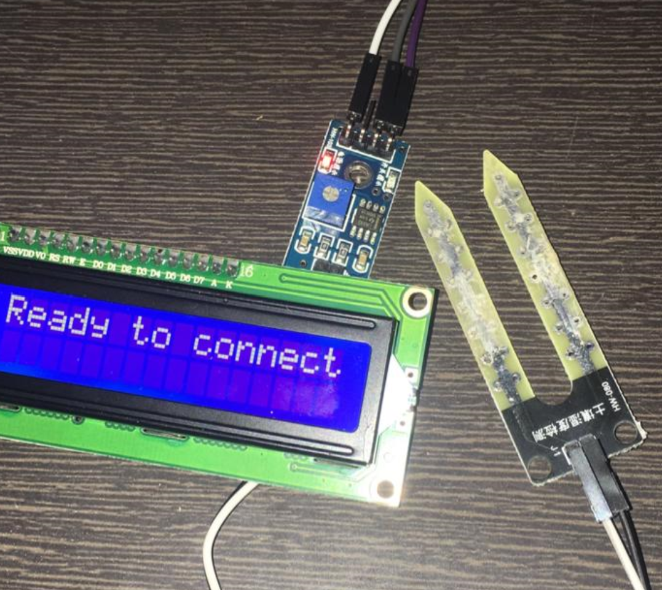
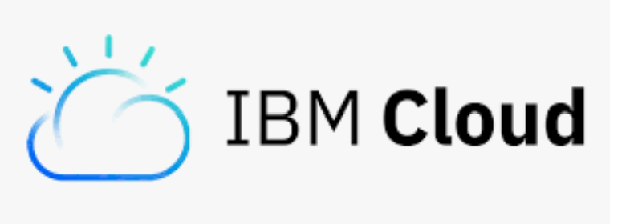
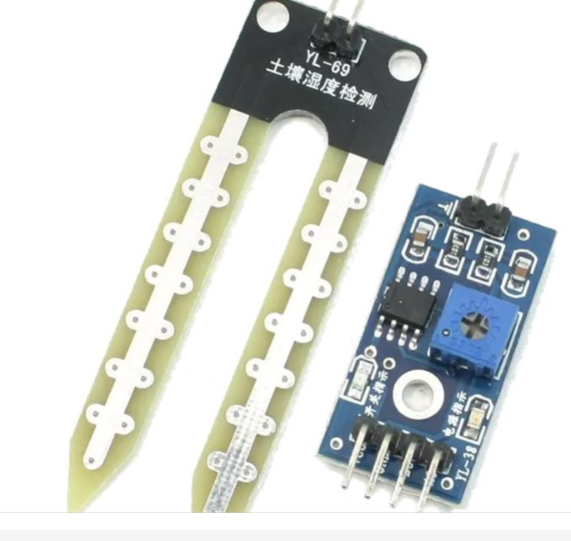



Tool Kit & Feasibility
Soil Dampness Sensor
Weather API –
IBM Cloud Service –
.net Framework
GitHub
Arduino
LCD Display unit

Slide 7

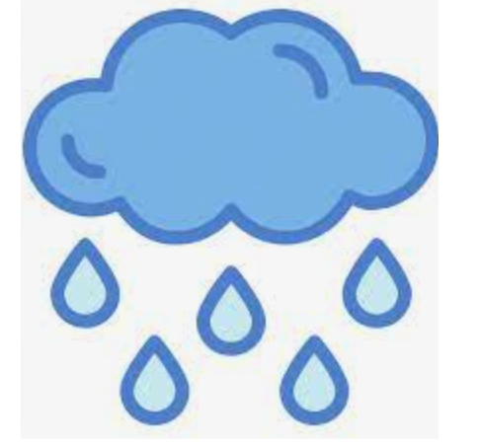


LIVE DEMO
I’m thirsty .. I’m happy…

Slide 8
What’s in Store ..
Capacity calculation in Units
Reporting using AI / ML techniques
End user communication capability
Analytics at Control Center level
Automated outflow incase of water scarcity with proper channeling

Slide 9

Q & A
We are happy to answer now and in future too ☺
Water Saved is Water Served !

